Slide 1
Coursera Capstone Final Project – Bay Area Info
Daniel Bai
May 15, 2020

Slide 2
Motivation
Facts
San Francisco Bay Area – home of the Silicon Valley
Median housing prices of the area are a few times the national average
Questions
How is one place (e. g., zip code) in the area different than another?
Population, income, housing price, school, ethniticy distribution, crime rate etc
For someone new to the area, where is the best place to live?
For a business owner, where is the best place to open a business?
This project attempts to address these questions, using a subset of the data

Slide 3
Data
All zip codes of the bay area
https://data.sfgov.org/Geographic-Locations-and-Boundaries/Bay-Area-ZIP-Codes/u5j3-svi6
Latitudes and longitudes for all zip codes in California
https://public.opendatasoft.com/explore/dataset/us-zip-code-latitude-and-longitude/table/
Population by zip code for California (2019)
https://www.california-demographics.com/zip_codes_by_population
US nation-wide monthly housing price data by zip code : US (1996-2020)
https://www.zillow.com/research/data/
California’s by zip code tax data from IRS (2017)
https://www.irs.gov/statistics/soi-tax-stats-individual-income-tax-statistics-2017-zip-code-data-soi
Foursquare data via API calls to Foursquare.com
https://developer.foursquare.com

Slide 4
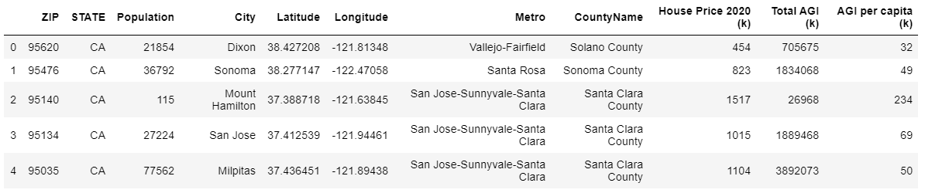
Master DataFrame
Data from multiple online sources are combined into the master pandas dataframe, which contains the zip code, city, county, and state name, longtitude and latitude, and population, housing price, and per capita income for total of 171 zip codes in the bay area

Slide 5
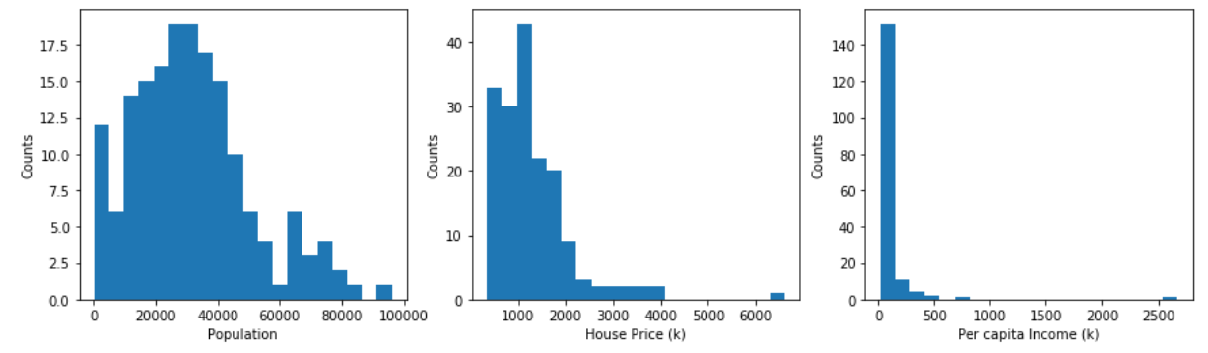
Exploratory Data Analysis
There is an outlier for both housing price and per capita income
They are the same zip code 94027, which is among the wealthiest zip codes of the area and nation wide

Slide 6
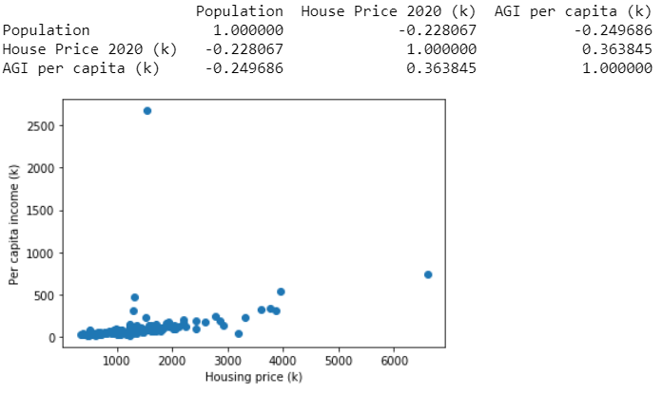
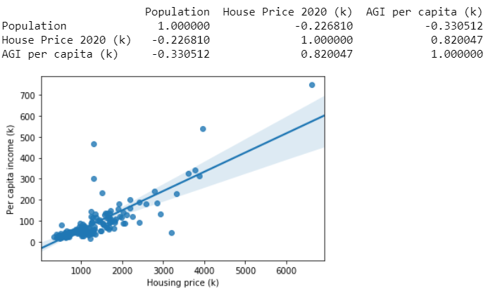
Exploratory Data Analysis Cont’d
Outlier removed
Cross correlation shows the correlation between housing price and per capita income is low, and it was driven by an outlier data point
After removing the outlier, correlation improved from 0.36 to 0.82
For next steps only per capita income is used, together with population

Slide 7
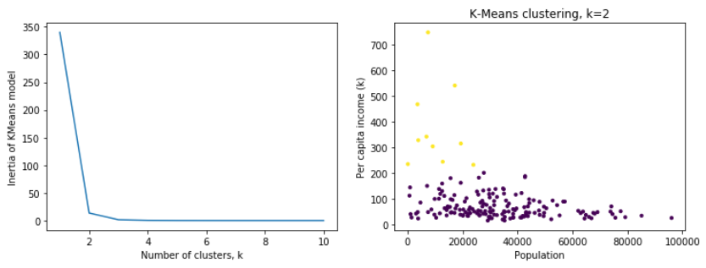
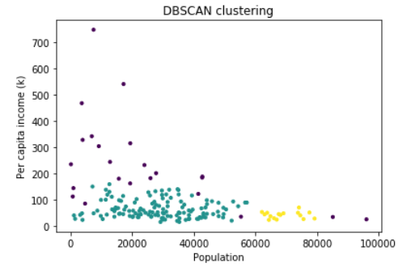
Clustering: K-Means and DBSCAN
K-Means
DBSCAN
Clustering was tried for population and per capita income data using both K-Means and DBSCAN. K-Means used k=2 determined by elbow plot
Both K-Means and DBSCAN do not show very clear clustering of data, because the data distribution is more continuous rather than clustered

Slide 8
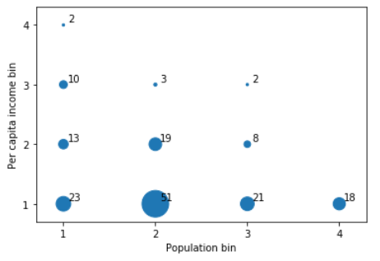
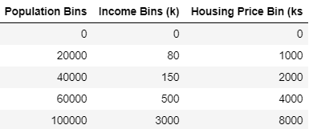
Binning of Data
Population, housing price, and per capita income for each zip code of the bay area are assigned into 4 bins each using the ranges in the table at the left
Statistics of population and per capita income falling into each of the 4x4 = 16 bins are shown on the plot at the right, with the marker size and the number denoting the total number of zip codes in the bin
The 32 zip codes in the blue box are of more interest for businesses because they have relatively higher population and per capita income, thus more spending power

Slide 9
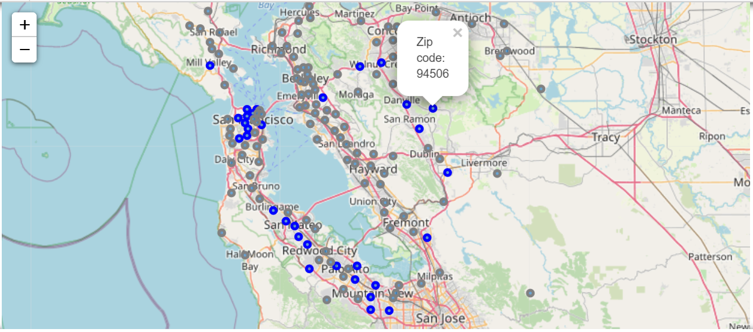
Maps – the 32 Zip Codes of Interest
The 32 zip codes of interest with higher population and per capita income are displayed using folium on the map highlighted in blue, the rest of the zip codes are in gray
Clickable marker displays the zip code

Slide 10
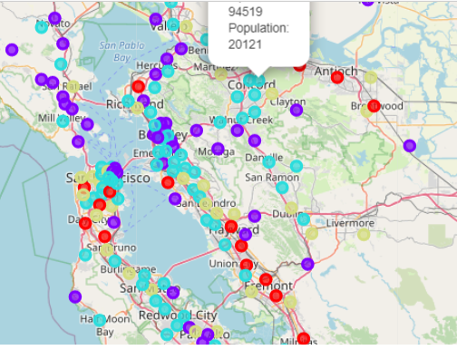
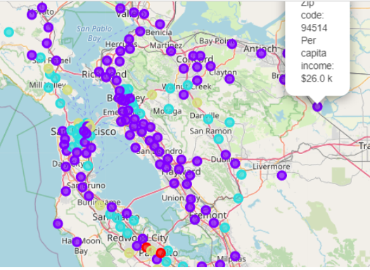
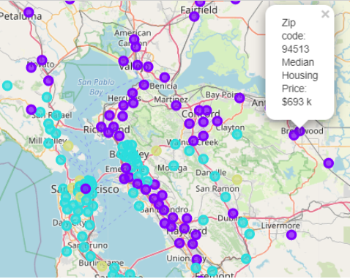
More Maps
Population
Per capita income
Housing Price
All 171 zip codes are displayed in three maps, each color coded for the 4 bins for population, per capita income, and housing price

Slide 11
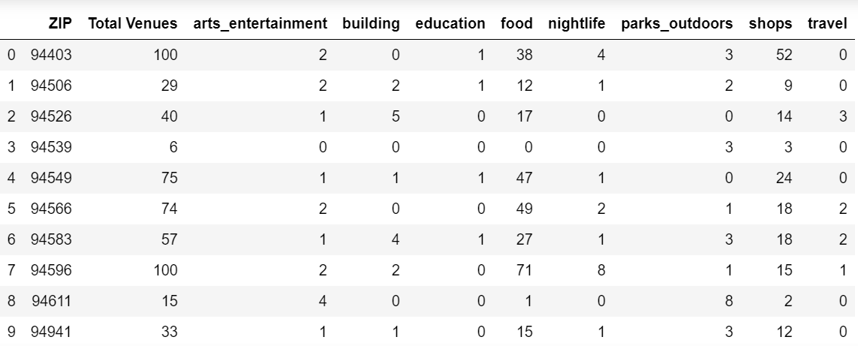
Explore the Area – Venues
Using Foursquare API calls, pulled the venues within 1000 meters radius of the center of each zip code, and further separated into high level categories, i.e., food, shops, travel etc

Slide 12
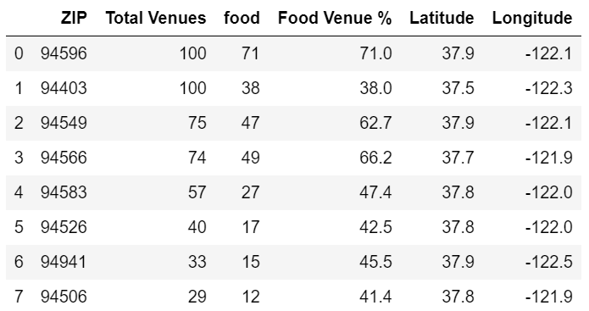
Top 8 Zip Code with Most Venues
Top 8 zip codes with most venues are listed, together with the food related venues
As an example, the top two zip codes have the same number of venues within the search radius, but different number of food related venues, so zip code 94403 may be preferred over 94596 thanks to less competition

Slide 13
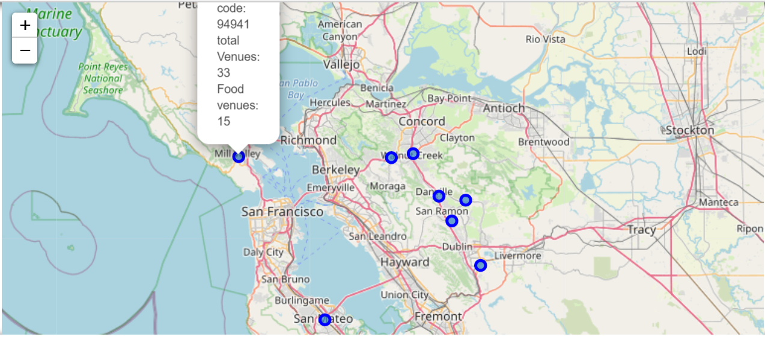
Top 8 Zip Code for Business Opportunities
The Top 8 zip codes with best business opportunities (using the limited data features) are displayed on the map with zip code, total number of venues within the search range, and food related venues shown by the clickable markers

Slide 14
Thank you!

